Slide 1


Slide 2

AIR QUALITY PREDICTION
TEAM member’s:-
Praveen Kumar
Varun Kanikaram
Surendra
Rohith
Sai Gopinadh

Slide 3
Introduction:- Air is one of the most essential natural resources for theexistence and survival of the entire life on this planet. Allforms of life including plants and animals depend on air for their basic survival. Thus, all living organisms need goodquality of air which is free of harmful gases to continue their life. According to the world&#39;s worst polluted places byBlacksmith Institute in 2008 [1], two of the worst pollutionproblems in the world are urban air quality and indoor airpollution. The increasing population, its automobiles andindustries are polluting all the air at an alarming rate. Airpollution can cause long-term and short-term health effects. It&#39;s found that the elderly and young children are moreaffected by air pollution. Short-term health effects includeeye, nose, and throat irritation, headaches, allergic reactions,and upper respiratory infections. Some long-term healtheffects are lung cancer, brain damage, liver damage, kidneydamage etc. and we are explaining about air quality predictionin Delhi According to data set there are 5 columns they are Ozone, Solar radiation, Air, Temp, Month, Day etc.

Slide 4
PROBLEM STATEMENT:- The purpose of this project is to identify the effect that surface modifications have on the urban area in Delhi phenomenon and related ozone problem in the metropolitan area of Delhi, IL. The basic hypothesis is that urban, summertime temperatures can be significantly lowered by increasing the vegetative landscape cover and enhancing the solar reflectivity of paved and roofed surfaces within an urban area. It is proposed that in addition to a decrease in temperature, the modification of an urban surface to include more vegetative cover and lighter, lower albedo surfaces will also reduce energy consumption, ozone exceedances, and detrimental environmental and human health effects associated with high levels of ozone.

Slide 5
DATASET:-
 | Ozone | Solar.R | Wind | Temp | Month | Day
0 | 41.0 | 190.0 | 7.4 | 67 | 5 | 1
1 | 36.0 | 118.0 | 8.0 | 72 | 5 | 2
2 | 12.0 | 149.0 | 12.6 | 74 | 5 | 3
3 | 18.0 | 313.0 | 11.5 | 62 | 5 | 4
4 | NaN | NaN | 14.3 | 56 | 5 | 5
5 | 28.0 | NaN | 14.9 | 66 | 5 | 6
6 | 23.0 | 299.0 | 8.6 | 65 | 5 | 7
7 | 19.0 | 99.0 | 13.8 | 59 | 5 | 8
8 | 8.0 | 19.0 | 20.1 | 61 | 5 | 9
9 | NaN | 194.0 | 8.6 | 69 | 5 | 10
10 | 7.0 | NaN | 6.9 | 74 | 5 | 11
11 | 16.0 | 256.0 | 9.7 | 69 | 5 | 12
12 | 11.0 | 290.0 | 9.2 | 66 | 5 | 13
13 | 14.0 | 274.0 | 10.9 | 68 | 5 | 14
14 | 18.0 | 65.0 | 13.2 | 58 | 5 | 15
15 | 14.0 | 334.0 | 11.5 | 64 | 5 | 16
16 | 34.0 | 307.0 | 12.0 | 66 | 5 | 17

Slide 6
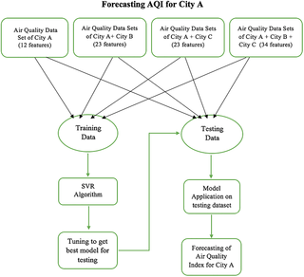
algorithm:-

Slide 7
OBJECTIVES OF RESEARCH:- Solar radiation Wind Temperature

Slide 8

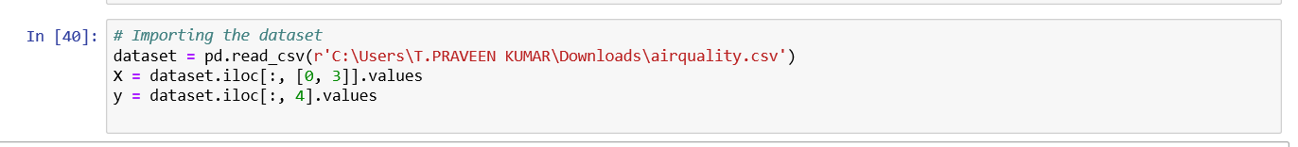
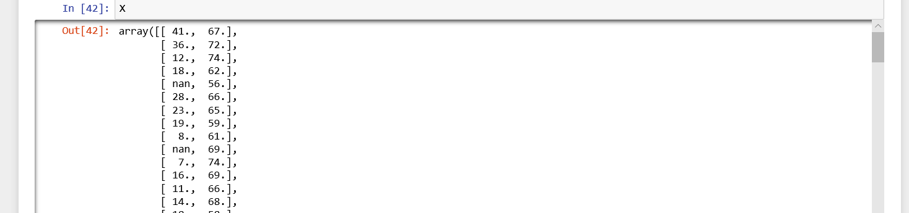
Procedure:-

Slide 9
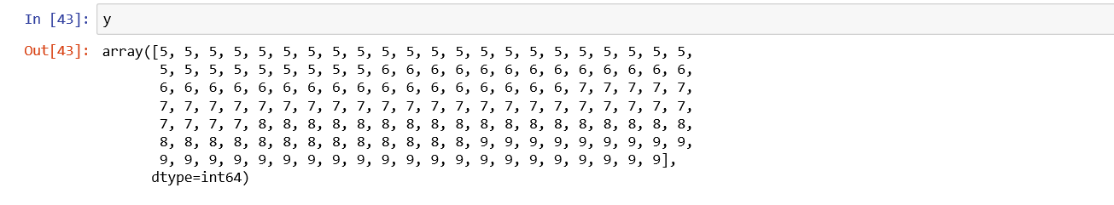
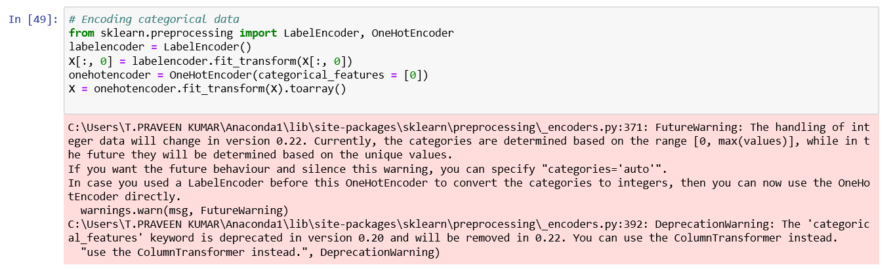

Slide 10
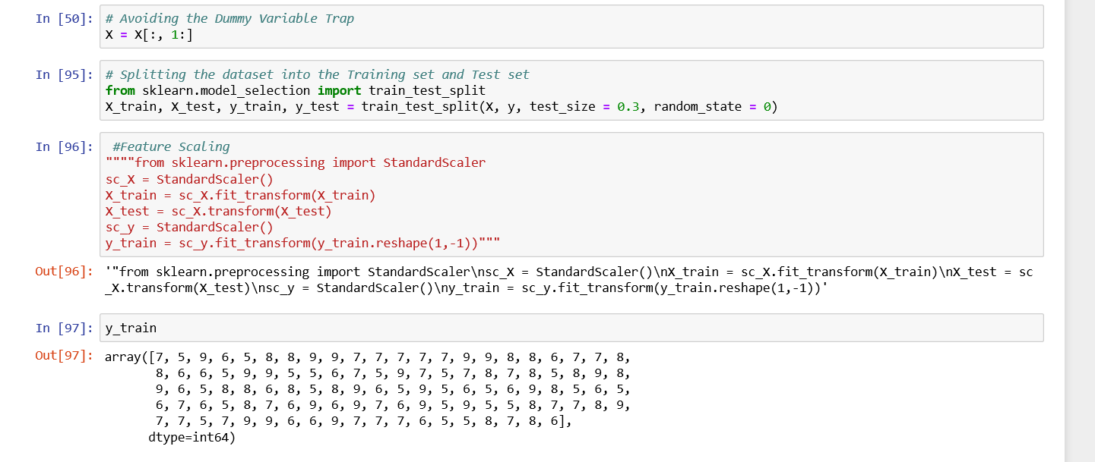

Slide 11
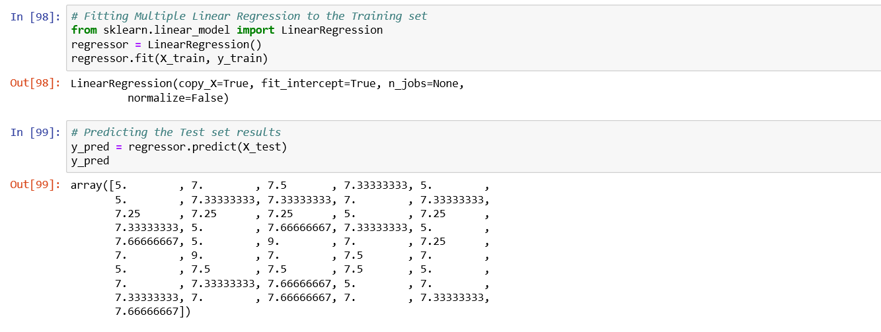

ACCURACY:-

Slide 12
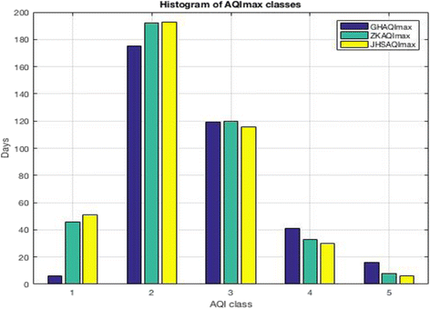
GRAPH:-

Slide 13
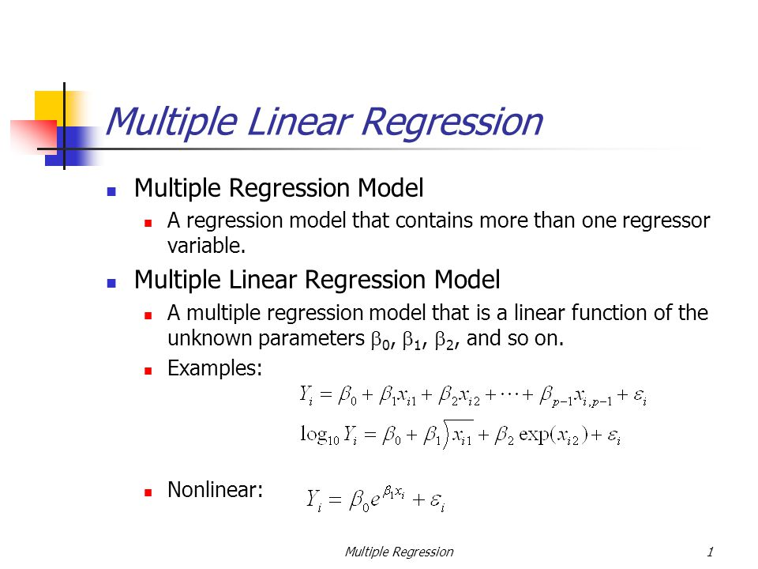
MODEL:-

Slide 14
METHODOLOGY OF AIR QUALITY PREDICTION:-
The principal stages of the proposed methodology are:
Multi Linear Regression
1.In this method we are use Multi Linear Regression For to
find Air Quality Prediction
2. Generation of a mathematical formalization for this model.
3. Creation of a multivariate hierarchical structural model
based on system analysis.
4. These coefficients allow an epidemiological meaningful
model interpretation.

Slide 15
STATISTICAL TECHNIQUES AND DATA VISUALIZATION:-
Air quality simulation models have been the subject ofextensive evaluations to determine their performance undera variety of environmental and meteorological conditions.While much information has been gathered, no clearlydefined methodology exists for comparing the performanceof two or more models. The purpose of this paper is topresent a statistically oriented procedure to test if theperformance of one model is superior to others using acomposite performance index involving the bootstrapresampling technique
The detection of NO 2 by its chemiluminescent reaction withluminol is a rapid and sensitive means of measuringatmospheric NO 2 . However, testing and field use of acommercial NO 2 monitor employing this detection schemehave shown that several corrections are necessary in order toobtain accurate NO 2 data at low concentrations. In useaboard aircraft, the NO 2 data must be corrected for zero
offset, altitude (i.e. pressure), nonlinearity of response.

Slide 16
Air Quality Forecasts:-
The District is attaining the national ambient air quality standards (NAAQS) for all pollutants except ground-level ozone. Ground-level ozone, also known as smog, is created by a chemical reaction between precursor pollutants, primarily oxides of nitrogen (NOx) and volatile organic compounds(VOCs) in the presence of sunlight and high temperatures.
“Ozone season” lasts from May to September. During ozone
season, air quality forecasters rate the quality of the air on a
daily basis and recommend actions when predictions indicate
that air quality may be bad for public health.

Slide 17
FINDING AND SUGGESTIONS:-
@ Raise awareness about air pollution. ...
@ Run tree plantation drives. ..
@ Conserve energy. ...
@ Curb Unbridled Industrialization. ...
@ Reduce use of personal vehicles. ...
@ Let your vehicles stick to pollution control norms. ...

Slide 18

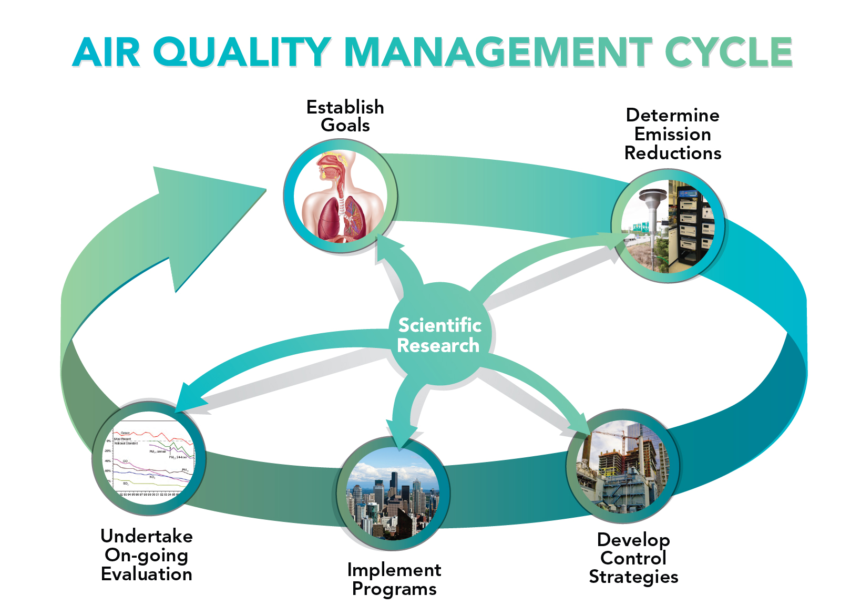
THE AIR QUALITY CYCLE

Slide 19
CONCLUSION:-
We performed a series of analyses, and came to some rather interesting conclusions. Our methodology included collecting the Air Quality Index (AQI) data in four areas in Delhi in 2016 as well as 2015 and drawing spatial as well as temporal comparisons to give a clear picture of what was happening. We also collected data from 2014 but it was sparse, and yet it supported our findings definitively, if not conclusively. One of the most relevant is the fact that this year was truly anomalous, if only firecrackers are considered major pollutants during and after 30th October. Comparing the AQI this year to that observed in 2015, it was obvious that firecrackers could not have caused the shocking level of pollution seen this year.

Slide 20





PRESENTED BY:-

Slide 21


